Slide 1
Reopen Perception
Lingyao Li, Abdolmajid Erfani, Yu Wang, Qingbin Cui, and Gregory Baecher

Slide 2
Research Backgrounds
Most states started to lift lockdown order on May.
The reported cases keeps going up.
Would it be possible to track people’s perception for reopening?
Traditional Surveys. However:
Respondents may not feel encouraged to provide accurate, honest answers or may not feel comfortable providing answers that present themselves in a unfavorable manner.
Surveys with closed-ended questions may have a lower validity rate than other question types.
The number of respondents who choose to respond to a survey question may be different from those who chose not to respond, thus creating bias.
Survey question answer options could lead to unclear data because certain answer options may be interpreted differently by respondents.
Reopen Perception

Slide 3
Research Motivations
User social media to investigate public perception for reopening policy
Large quantity, spatial converge, cost effectiveness
Provide real-time track on public perception
People on social media can freely express their opinions to such policy. Such opinions are often unbiased and have high fidelity when compared to survey results.
Reopen Perception

Slide 4
Data Retrieving
Search Keyword: reopen
Search date range: April 17 ~ May 30
Total number of records with US registration locations: 2,407,911
Total number of top unique 5000 tweets: 1,419,457 (?)
Total number of records after data cleaning: 1,591,216
Total number of unique tweets after data cleaning: 450,540
Reopen Perception

Slide 5
Sampling and Labeling
We grouped the data based on the frequency and manually read and label the top 5000 samples.
Which tweet should be considered as supporting reopen or opposing reopen?
Reopen Perception

Slide 6
Examples
RT @Annakhait: How about we REOPEN, and whoever wants to say home can stay home!
(class 1)
RT @laurenboebert: The best way to stimulate the economy is to reopen America. Who’s with me?
(class 1)
Reopen Perception
RT @RepAdamSchiff: We can’t safely reopen the economy until we can test millions of asymptomatic people and find out who can spread the virus. That requires a massive testing infrastructure and robust contact tracing we don’t yet have.
https://t.co/vYr3kAKMTz
(class -1)
RT @IngrahamAngle: Georgia to reopen some businesses, including gyms and salons https://t.co/UV0aMAQwyq
(class 0)
A few exceptions
RT @keithedwards: America getting ready to reopen https://t.co/b6mM0M5cxH
(class -1)

Slide 7
Text Classification - Algorithm Design
Step 1: Text Cleaning
Step 2: Text Up-sampling
Step 3: Text Vectorization
Step 4: Text Classification
Reopen Perception

Slide 8
Text Cleaning
Step 1: remove zero patterns
Step 2: remove URLs, @user, RT @user:,
Step 3: remove punctuations, emojis, digits
Step 4: tokenize words
Step 5: lemmatize words
Step 6: remove stop-words
Reopen Perception

Slide 9
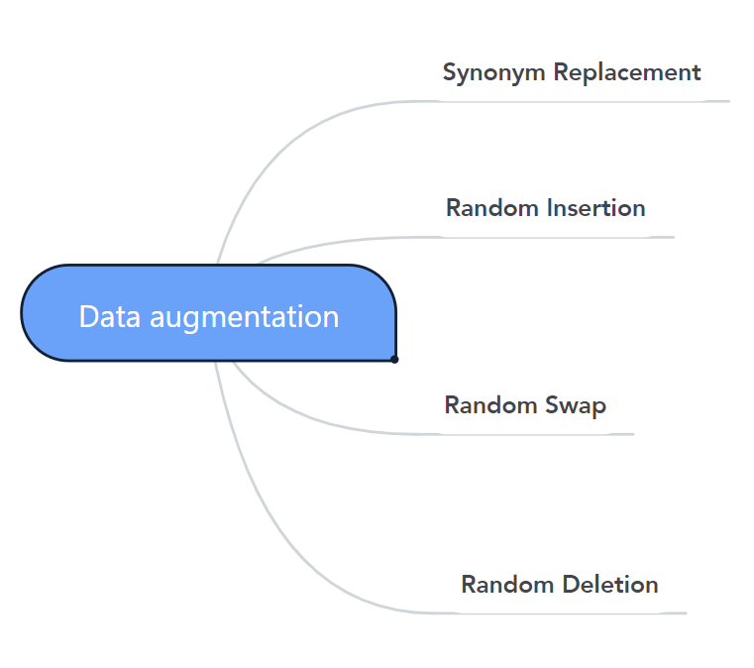
Text Up-Sampling
Reopen Perception
Original: lack test coronavirus scandal national say
SR+RI: lack test coronavirus scandal national outrage say
RS+RS: exam lack test coronavirus national scandal say
RS: lack coronavirus test national scandal say
Results:
Class -1 – 1946 → 9730
Class 1 – 1629 → 9774
Notes:
Synonym Replacement (SR): Randomly choose n words from the sentence that are not stop words. Replace each of these words with one of its synonyms chosen at random.
Random Insertion (RI): Find a random synonym of a random word in the sentence that is not a stop word. Insert that synonym into a random position in the sentence. Do this n times.
Random Swap (RS): Randomly choose two words in the sentence and swap their positions. Do this n times.
Random Deletion (RD): For each word in the sentence, randomly remove it with probability p.
Setting for parameter: change probability-----p_sr=0.1, p_ri=0.1, p_rs=0.1, p_rd=0.1 ----- based on the words number, the minimum number is 1
The number of augmentation n is 5 based on the number of signal and nonsignal

Slide 10
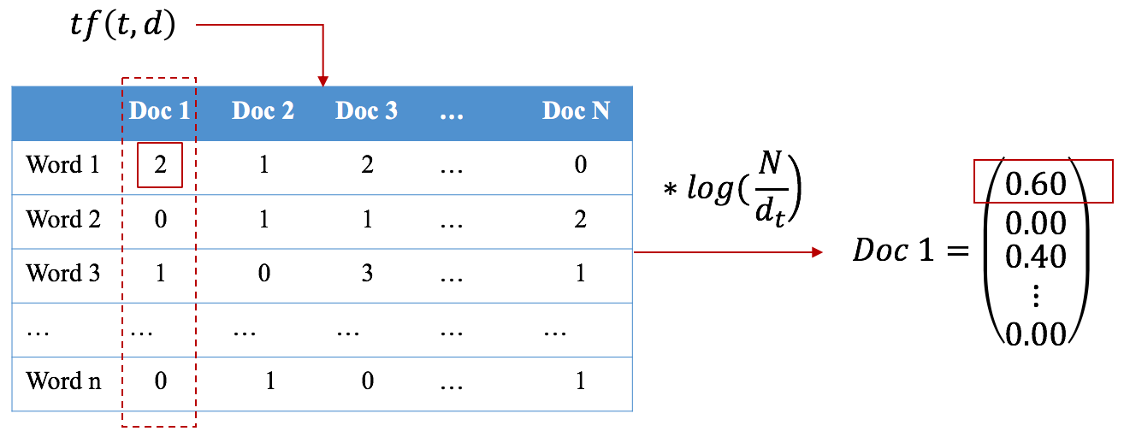
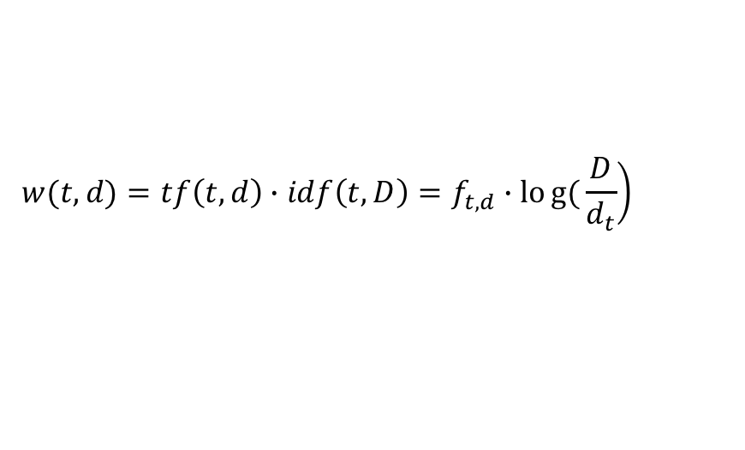
Text Vectorization
Term Frequency and Inverse Document Frequency
Reopen Perception
$$\left.w(t,d)={tf\left(t,d\right)∙idf\left(t,D\right)=f}_{t,d}∙log{(}\frac{D}{d_{t}}\right)$$

Slide 11
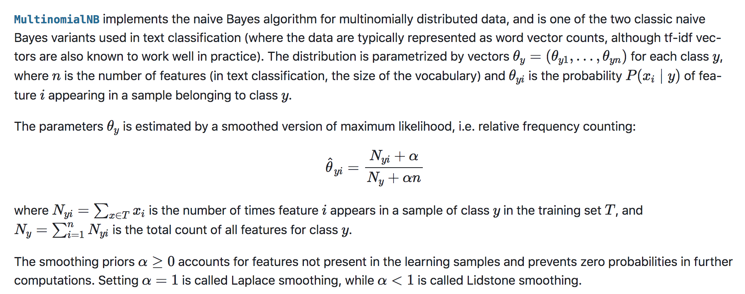
Text Classification
https://scikit-learn.org/stable/modules/naive_bayes.html#multinomial-naive-bayes
Bayes, Support Vector Machine, Logistic Regression.
In this research, we use Multinomial Bayes to train the model.
Reopen Perception

Slide 12
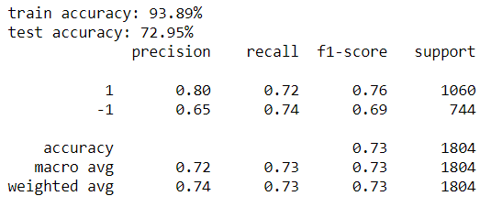
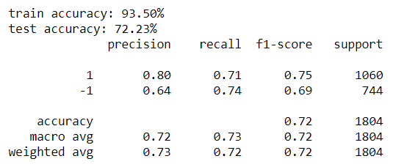
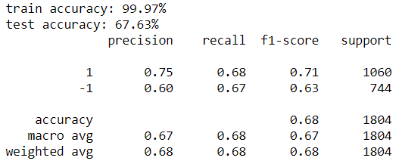
Performance
Reopen Perception
TF-IDF + Bayes
TF-IDF + SVM
TF-IDF + Logistic

Slide 13
Application to Dataset
Rank frequency & Select top 5000
Original Dataset
XXX% Data –
manual labeled
Reopen Perception
Text Classification
Apply model
XXX% Data –
not labeled
Trained Model
Subsequent analysis
XXX% Data –
system labeled
Final Dataset

Slide 14
Temporal Analysis
Reopen Perception

Slide 15
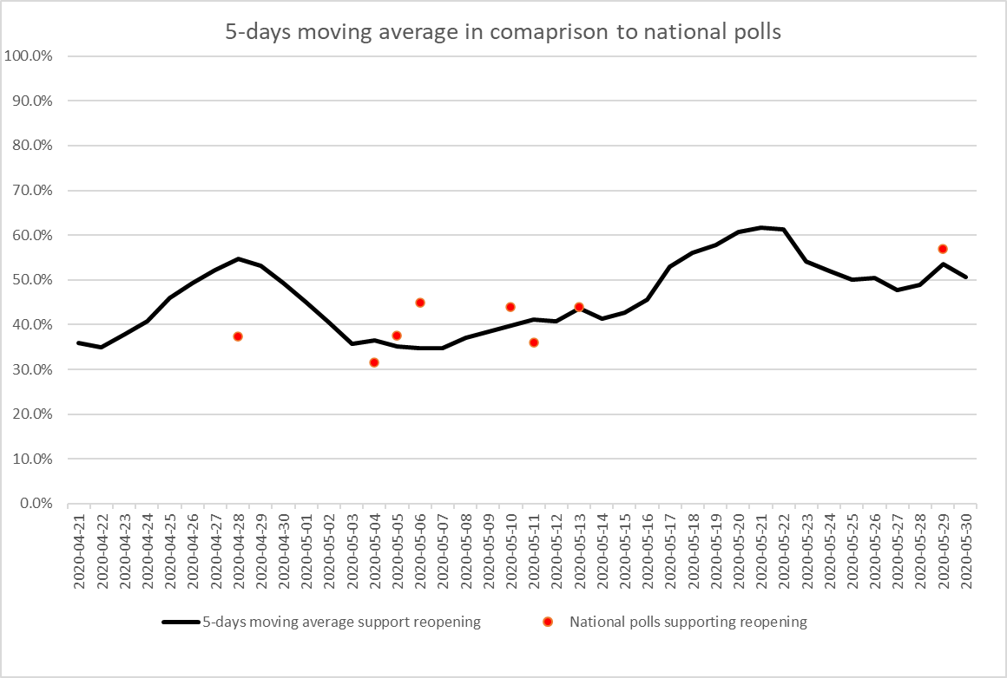
Temporal Analysis
Trend lines, in comparison to national polls:
Reopen Perception
28-04: https://www.surveymonkey.com/curiosity/fortune-poll-reopening-economy/
04-05: https://www.monmouth.edu/polling-institute/reports/monmouthpoll_us_050520/
05-05:https://navigatorresearch.org/wp-content/uploads/2020/05/Navigator-Daily-Tracker-Topline-F05.05.20.pdf
10-05:https://www.cnn.com/2020/05/12/politics/cnn-poll-americans-uncomfortable-routines/index.html
11-05:https://www.marketwatch.com/story/a-majority-of-americans-say-reopening-the-country-from-coronavirus-restrictions-isnt-worth-the-risks-2020-05-08
13-05:https://www.businessinsider.com/poll-as-trump-pushes-to-reopen-republican-voters-support-2020-5
29-05:https://mclaughlinonline.com/2020/05/29/newsmax-article-mclaughlin-poll-majority-want-reopen-of-economy-schools-churches/
Notes:
Ratio. Center 13.5

Slide 16
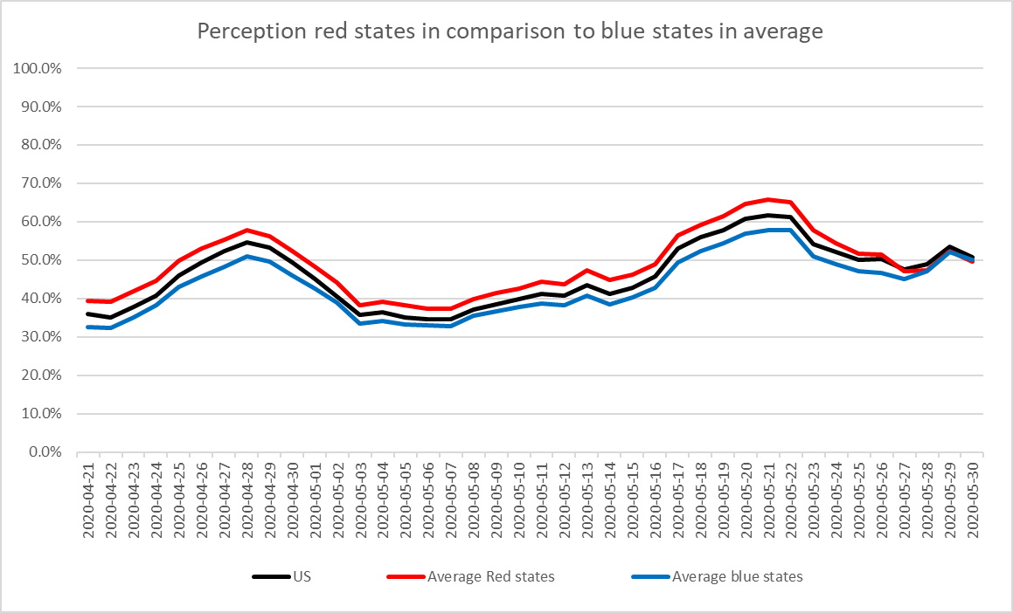
Temporal Analysis
During the study period red states report higher public perception except at the end of May
Reopen Perception
Notes:
Ratio. Center 13.5

Slide 17
Top states based on average perception in study period
Red and blue selection is based on
2016 presidential election
Notes:
Ratio. Center 13.5

Slide 18
Reopen Perception
:Daily ranking result
Temporal Analysis
Notes:
Ratio. Center 13.5

Slide 19
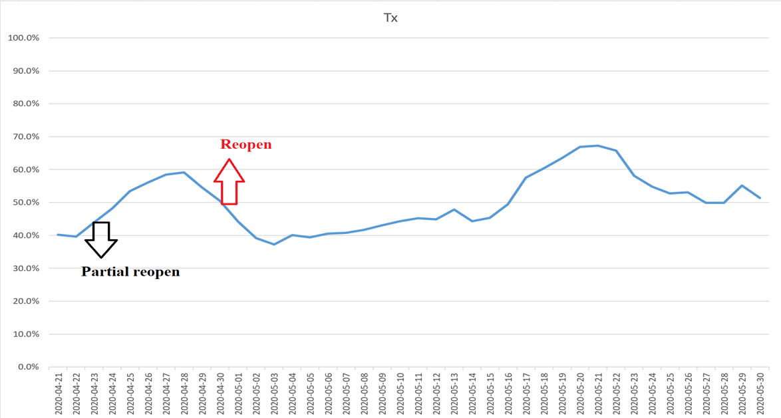
Public reaction to reopening policy
Reopen Perception
Early reopen Policy (before 5 May)
The pattern in state by state data shows, the people support an early “partial reopen” policy. The “full early reopen policy” most of the time receives a negative reaction by public
(some examples are presented; all states data is provided in excel)
Notes:
Ratio. Center 13.5

Slide 20
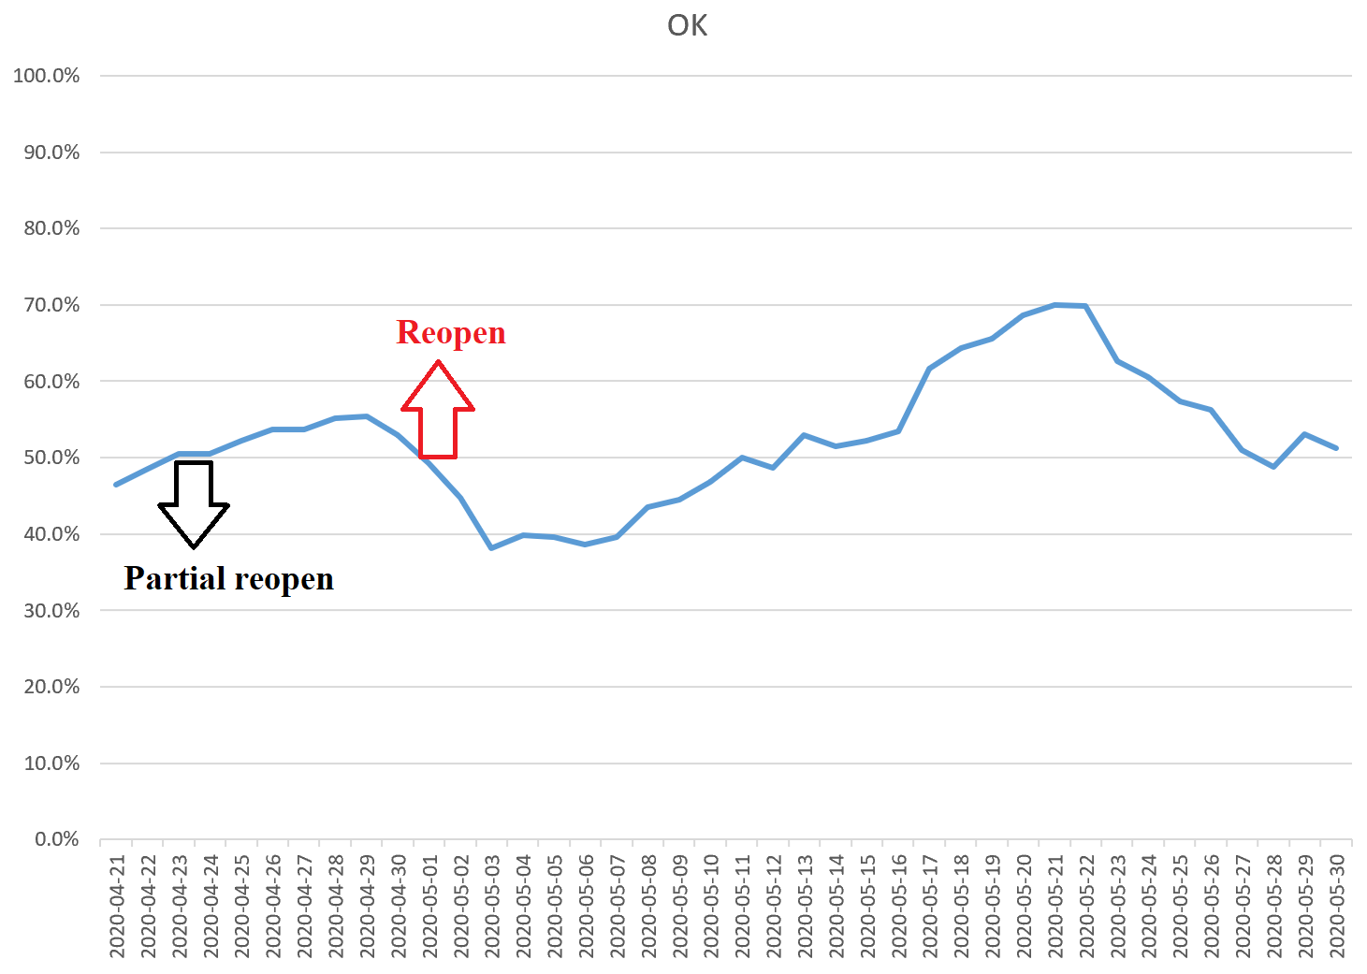
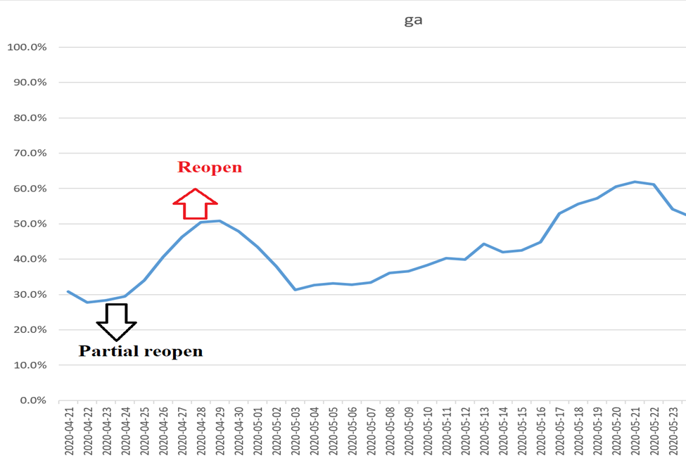
Public reaction to reopening policy
Reopen Perception
1) Early reopen Policy
Notes:
Ratio. Center 13.5

Slide 21
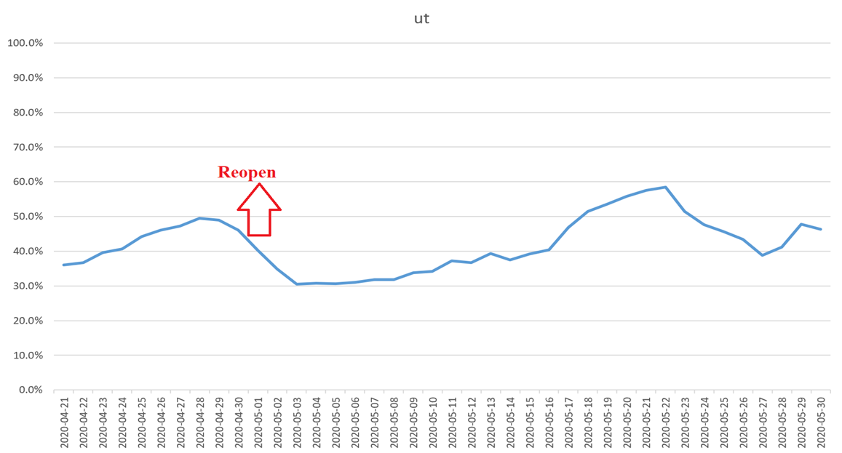
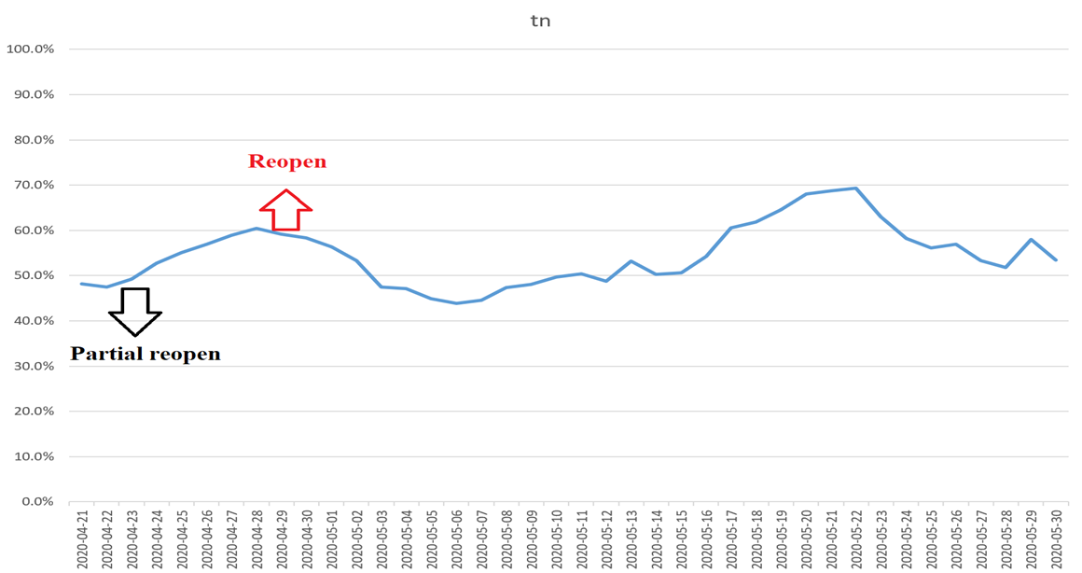
Public reaction to reopening policy
Reopen Perception
1) Early reopen Policy
Notes:
Ratio. Center 13.5

Slide 22
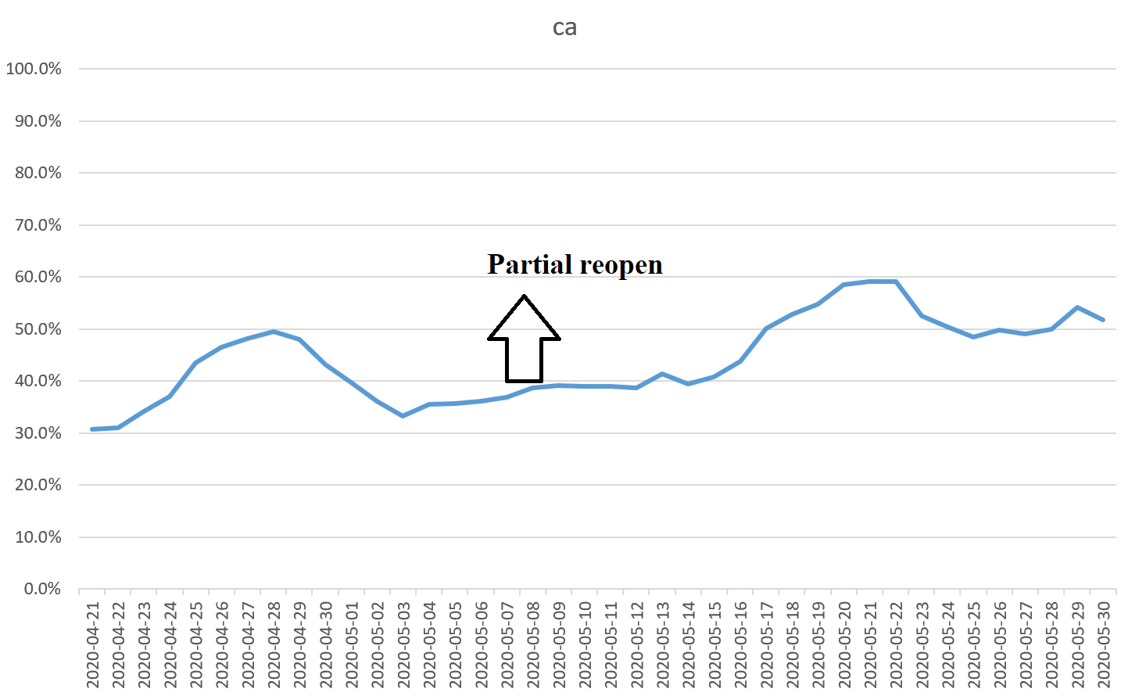
Public reaction to reopening policy
Reopen Perception
2) Middle reopen Policy
(5 May- 15 May)
The pattern indicates neutral reaction (or slightly positive) from publics to the middle reopen policy
(some examples are presented; all states data is provided in excel)
Notes:
Ratio. Center 13.5

Slide 23
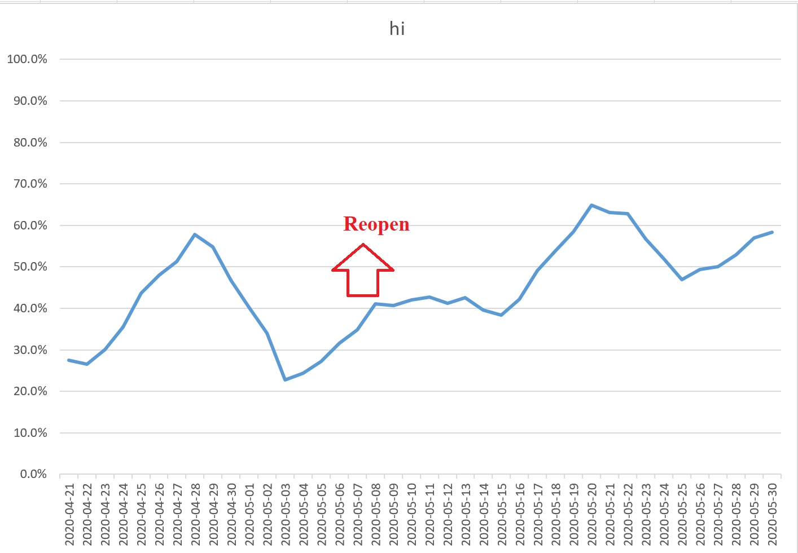
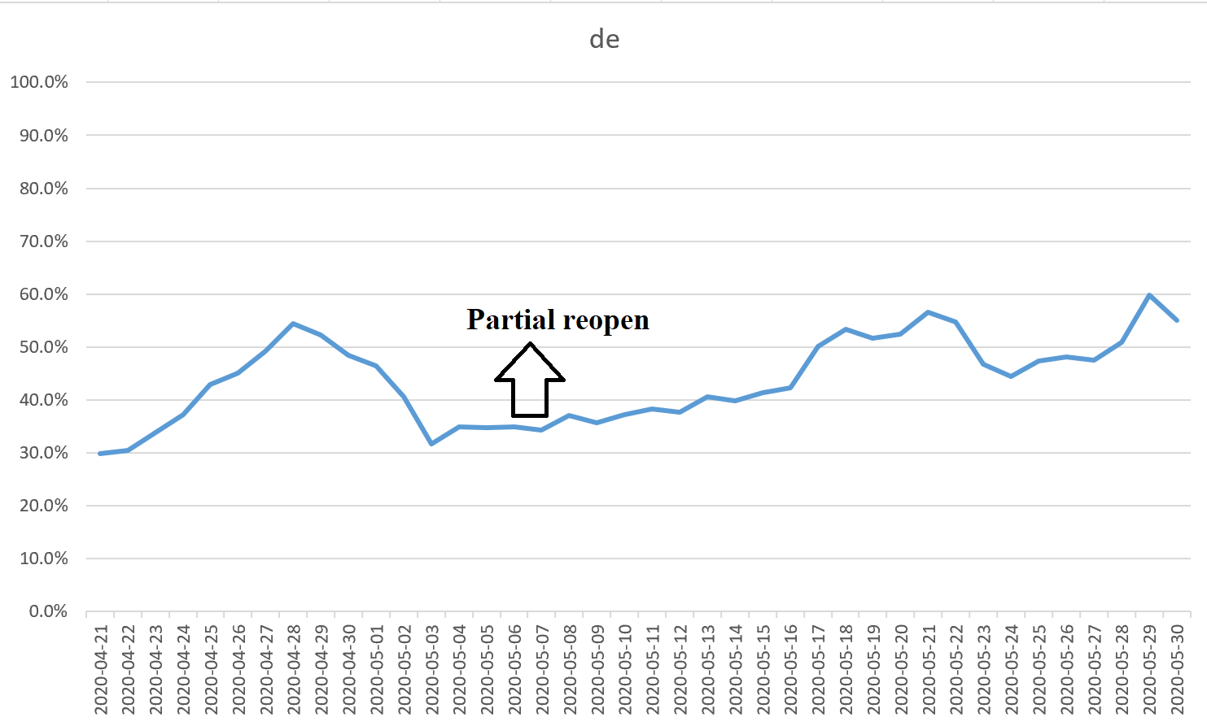
Public reaction to reopening policy
Reopen Perception
2) Middle reopen Policy
Notes:
Ratio. Center 13.5

Slide 24
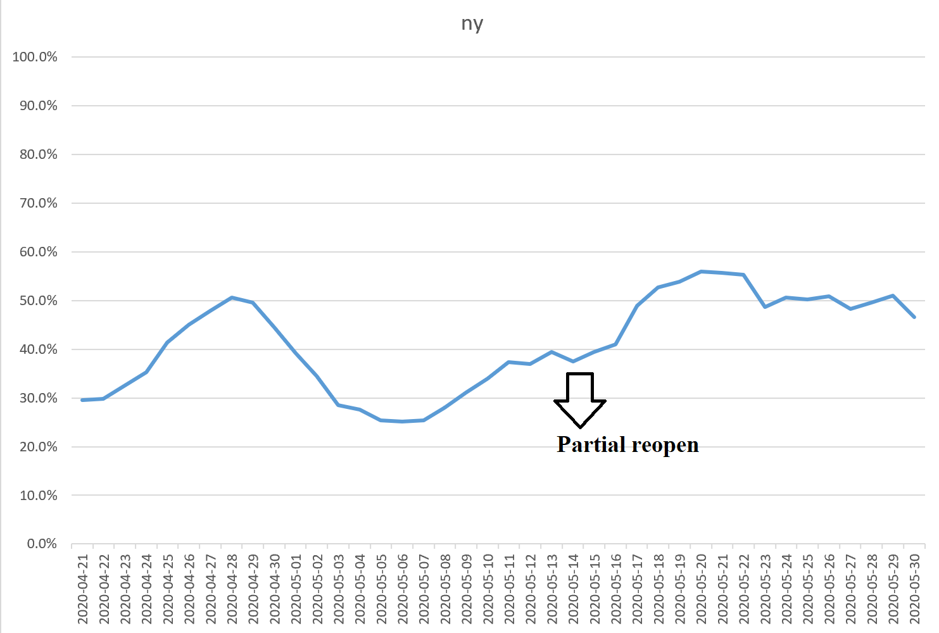
Public reaction to reopening policy
Reopen Perception
3) Late reopen Policy
(after 15 May)
The pattern shows strong support from public for late reopen policy, and usually there was a demand and increase before the reopen policy change
(some examples are presented; all states data is provided in excel)
Notes:
Ratio. Center 13.5

Slide 25
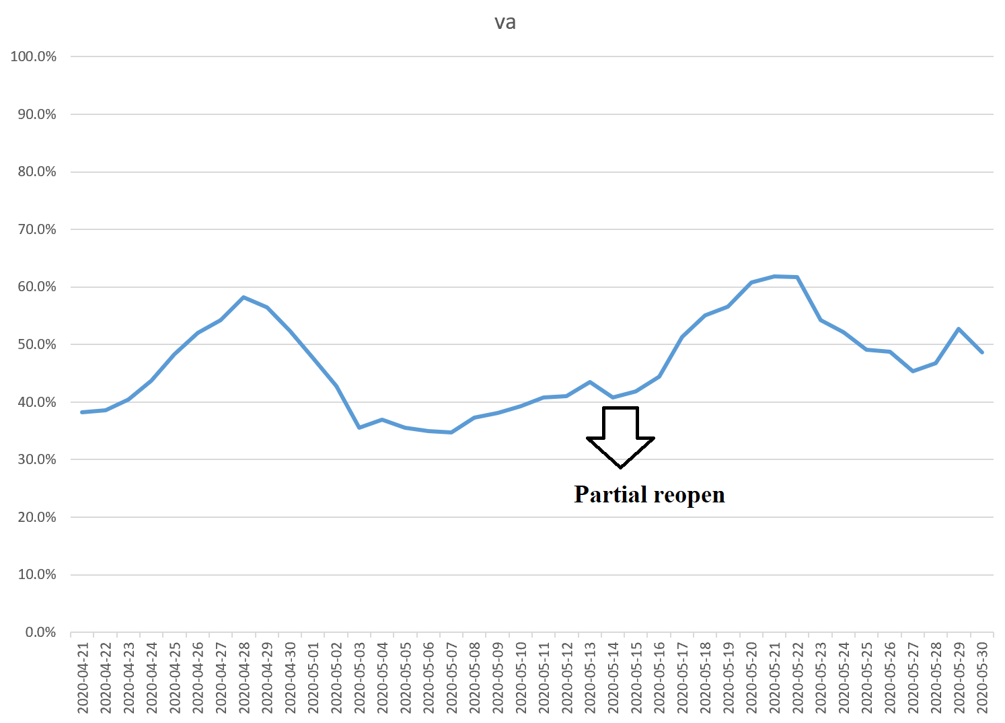
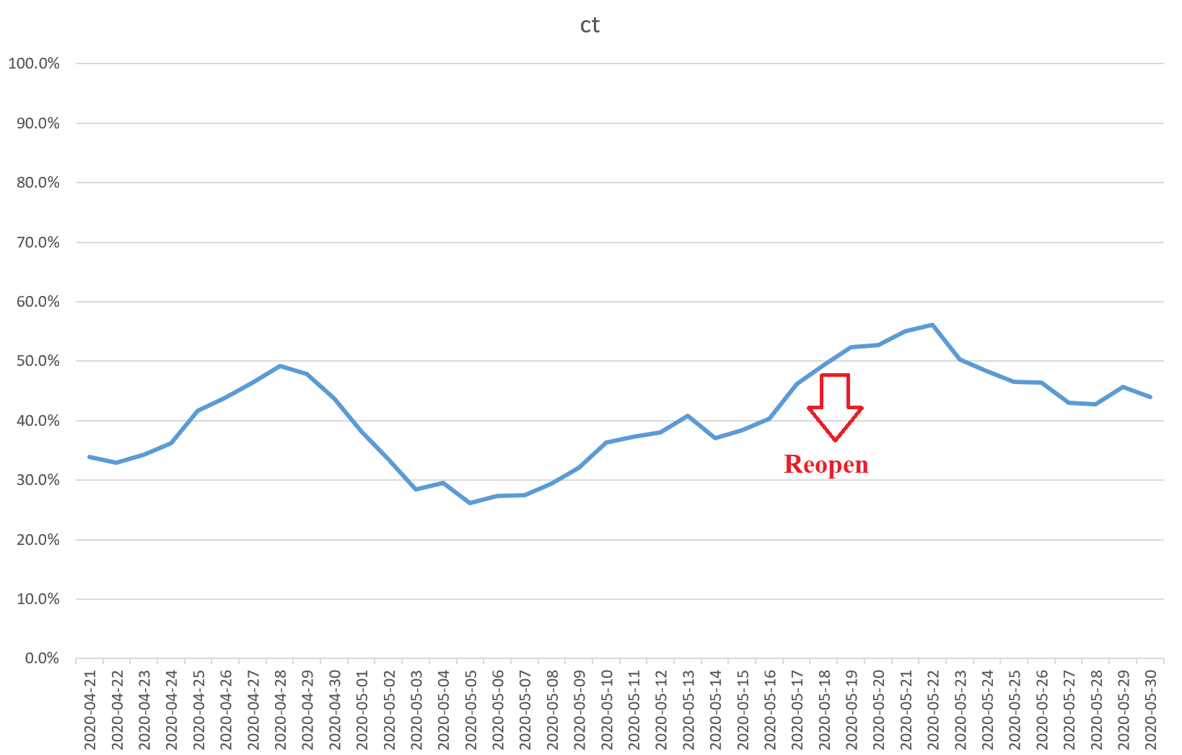
Public reaction to reopening policy
Reopen Perception
3) Late reopen Policy
Notes:
Ratio. Center 13.5

Slide 26
Temporal Analysis – News & Perception
Health Secretary says lockdown is also unhealthful for people; South Carolina reopens and reports no death for the first time
Disney World to reopen in July; Las Vegas Casinos to Reopen Next Week
Trump tweets support for reopen; Some states enters Phase 2 of reopening
Testing positive in NY reaches new low
Officials hides crucial health data as Trump pushes to reopen

Slide 27
Temporal Analysis – News & Perception
Major types of most frequent tweets:
Political/Policy news-driven (e.g., orders, plans, guidelines by president, governors and other politicians; party conflict; )
Pandemic facts-driven (e.g., death toll, new cases)
Scientific news-driven (e.g., scientific research findings, suggestion from experts)
Social events-driven (e.g., protest)
Economic facts-driven (e.g., unemployment)
Reasoning (express opinions with plausible reasons or logic)
Call/Warning (express opinions directly and concisely, not necessarily related to specific news or reasoning)
Real story (e.g. personal story and experience)
Funny stuff (accompanied by funny pictures or videos)
Blended type
Reopen Perception
Notes:
Ratio. Center 13.5

Slide 28
Temporal Analysis – News & Perception
Example of 4/17/2020
RT @RepAdamSchiff: There’s no way to safely reopen without massive testing. Yet we’re barely testing more people this week than last. And hospitals continue to report serious bottlenecks. If Trump ignores the experts and forces a premature reopening, Even more Americans will die. | -1 | Policy news + Pandemic facts. Trump Tweets Support for Protests
RT @FirstGentleman: President: Great things will happen when we reopen America! America right before it reopens: https://t.co/d7AbyeJOh0 | -1 | Policy news + Funny stuff. Trump Tweets Support for Protests + Funny picture
RT @kumailn: Here’s the thing: nobody wants stuff to remain closed. Nobody. Everyone wants everything to reopen as soon as possible. We just want to feel safe when that happens. That means, at the minimum, much more testing than we have right now. | -1 | Reasoning
RT @NoTotally: Given the data on who's dying, anyone who advocates for a reopen because "only" a percentage of people will die is, at the very least, implicitly advocating white nationalist logic | -1 | Reasoning + Pandemic facts.
RT @jimsciutto: Every expert says widespread testing is necessary to safely reopen the country. Virtually no state or local official we’ve spoken to says they have the capacity for widespread testing. How will this be fixed by May in a country of 330 million people? | -1 | Scientific news
RT @brithume: When POTUS claimed — incorrectly — that he had absolute power to reopen the country, there were cries of “authoritarian,” and “constitutional crisis.” Now that he’s largely leaving up to governors, he’s putting the “onus” on them, or the “burden” on them. | -1 | Policy news
RT @RepMattGaetz: I’m honored to be named to @POTUS’s Opening Up America Again Congressional Group. I will be working closely with President @realDonaldTrump and his administration to reopen our country and reignite the economic vitality America has enjoyed under his leadership. | 1 | Call
RT @thegoodgodabove: The only people who want to reopen the economy right now are the people who don’t care if you die. | -1 | Reasoning
RT @maddow: "Trump’s the-buck-stops-with-the-states posture is largely designed to shield himself from blame should there be new outbreaks after states reopen, according to several current and former senior administration officials involved in the response.“ https://t.co/azfY5dsPdj | -1 | Trump Issues federal guidelines for reopening state
Reopen Perception

Slide 29
Temporal Analysis – News & Perception
Conclusions & Implications
Political news gain more attention and invoke more debates
Most of the tweets with a large amount of retweets are related to political news — for both supporting and opposing reopen tweets.
Many top supporting reopen tweets are Calls
express opinions directly and concisely, not necessarily related to specific news or reasoning
A lot of perception spikes are caused by such calls, especially by Trump, Rand Paul.
For example, "REOPEN OUR COUNTRY!", "America getting ready to reopen" ,"Great things will happen when we reopen America!", "Many States moving to SAFELY and QUICKLY reopen!", "Let’s reopen America! "
Most top opposing reopen tweets express specific concerns
more likely to refer to pandemic facts and reasoning
Reopen Perception
Notes:
Ratio. Center 13.5

Slide 30
Temporal Analysis – News & Perception
Conclusions & Implications
Some media tends to twist Trump's words or state the policy made by Democrat/Republican in a tendentious way
The mostly likely result is that the topic is led to their desired direction
On the other hand, many people have stopped trusting anything the media say
The debate is somewhat not focused on the pandemic itself but is led to the party conflict
For example, many tweets express a political tendency that opposing reopening is to "sabotage President Trump“
For example, some people don’t like Democrat so that they tend to oppose the policy made by Democrat
People should be guided more properly to pay more attention to science and facts
Reopen Perception
Notes:
Ratio. Center 13.5

Slide 31
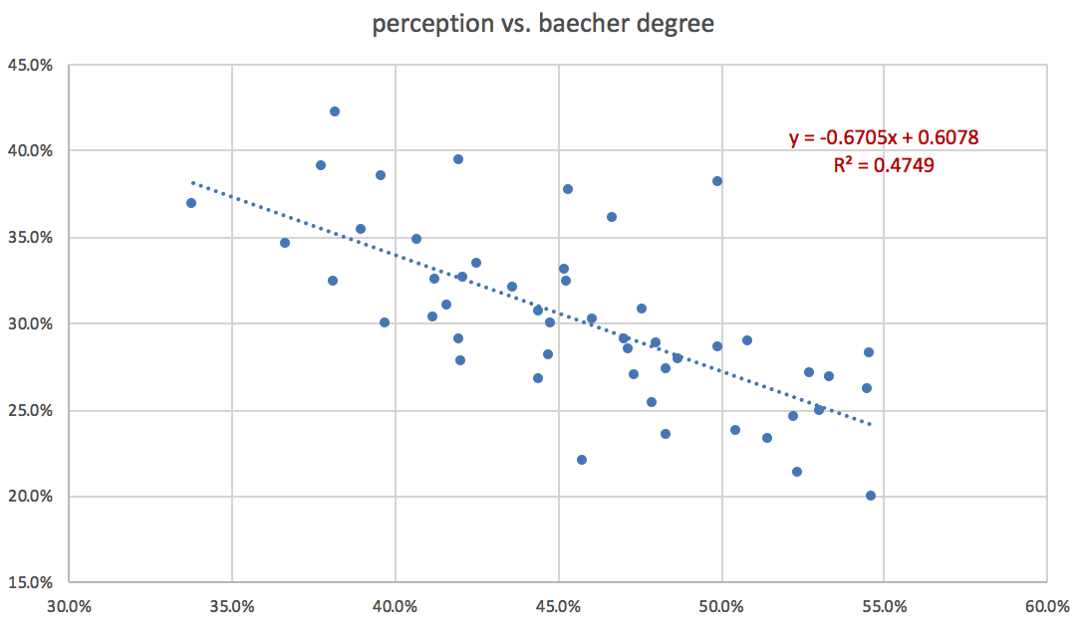
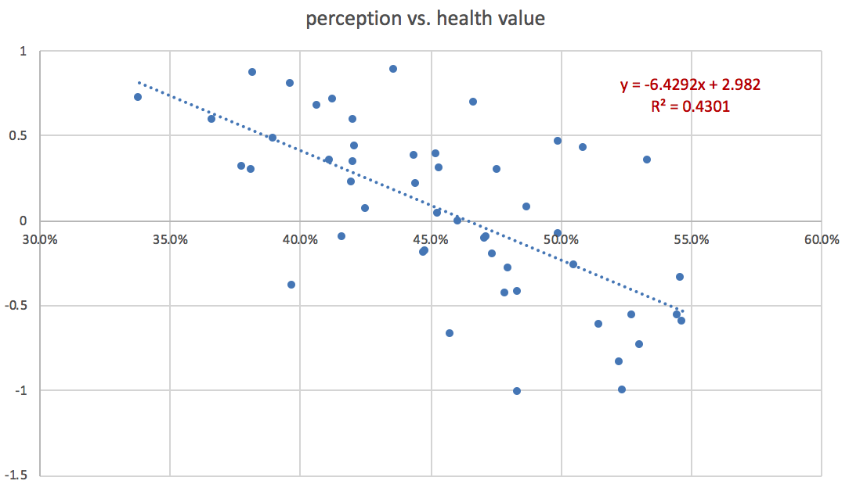
Spatial Analysis – Compared with Socioeconomic Factors
Reopen Perception
Notes:
Ratio. Center 13.5

Slide 32
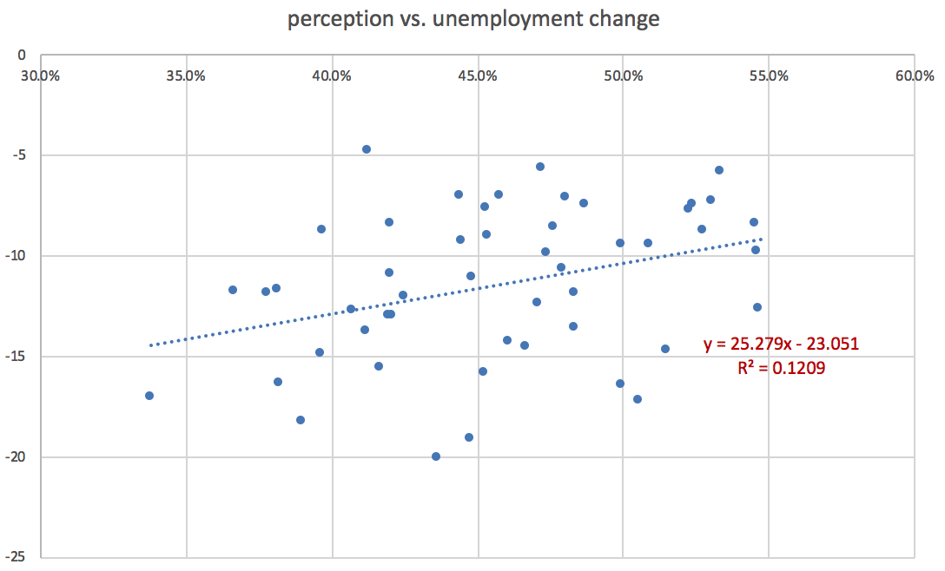
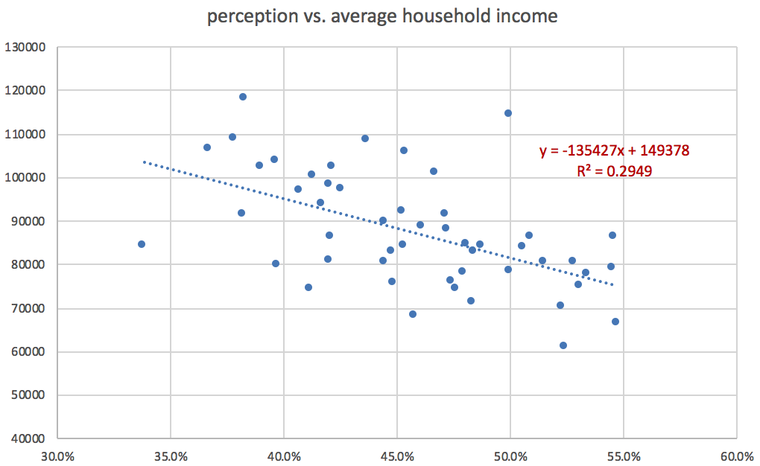
Spatial Analysis – Compared with Socioeconomic Factors
Reopen Perception
Notes:
Ratio. Center 13.5

Slide 33
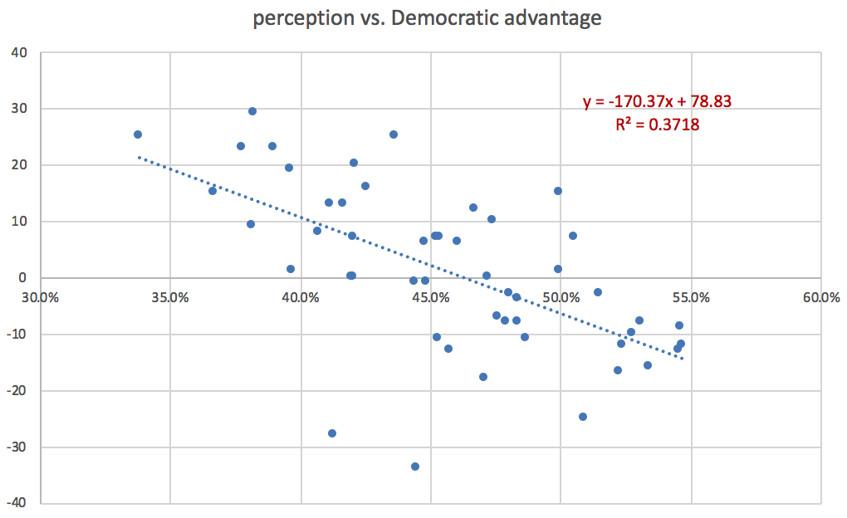
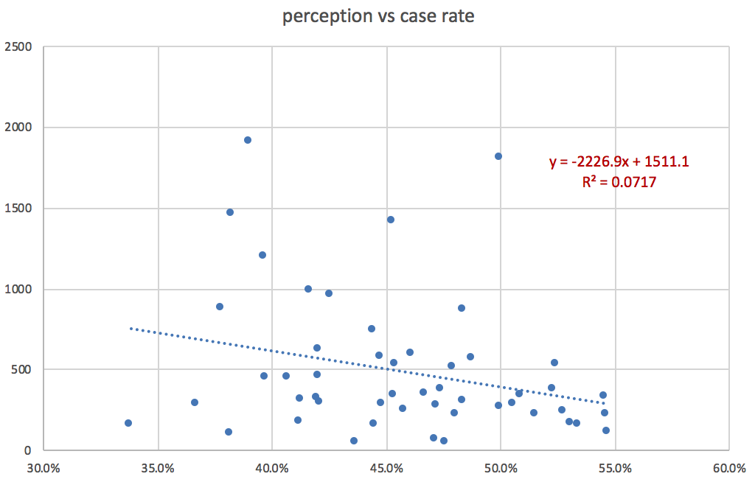
Spatial Analysis – Compared with Socioeconomic Factors
Reopen Perception
Notes:
Ratio. Center 13.5

Slide 34
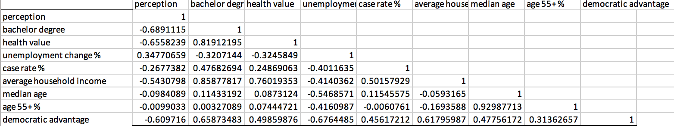
Spatial Analysis – Correlation
Reopen Perception

Slide 35
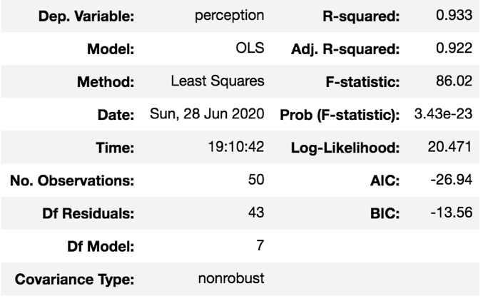
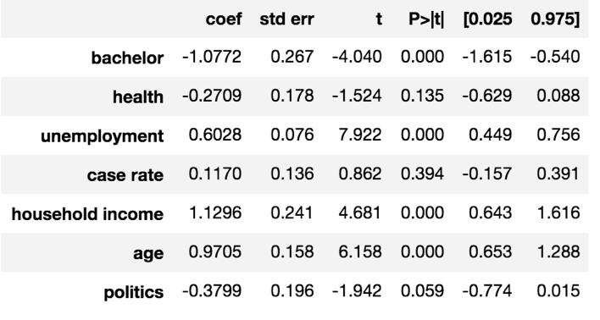
Spatial Analysis – Multiple Linear Regression
Reopen Perception

